Slide 1
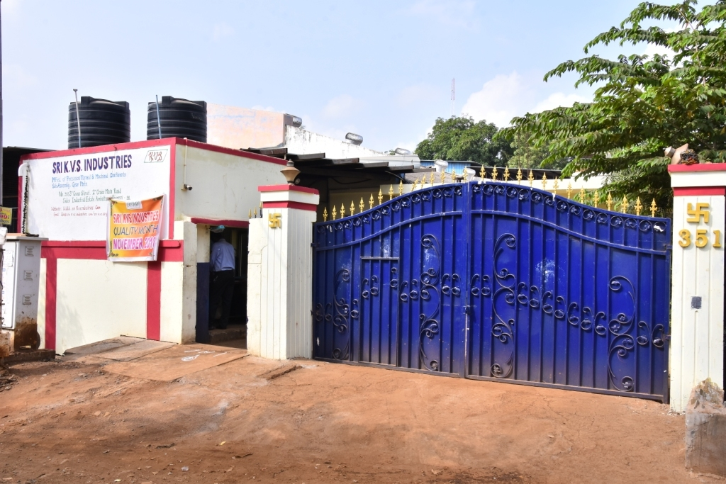
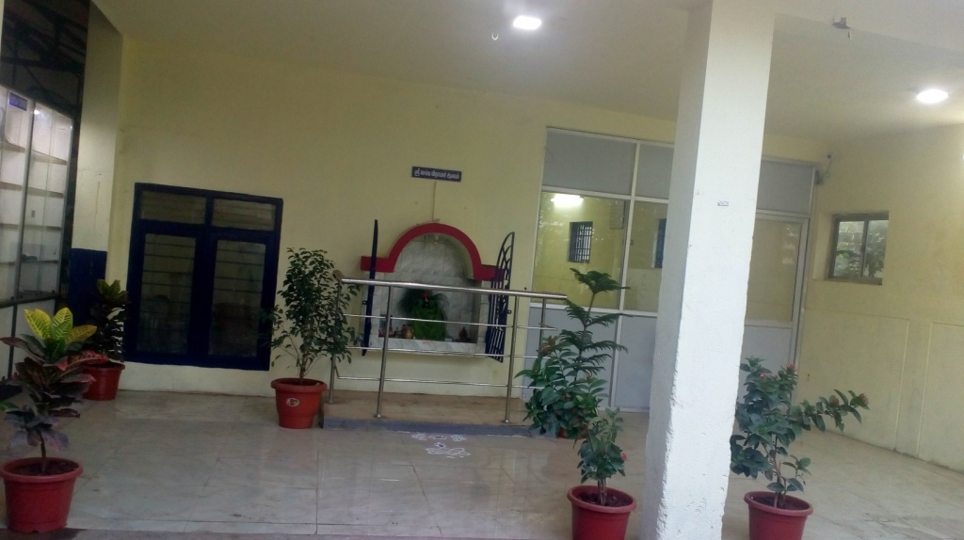
SRI KVS INDUSTRIES No.351, Sidco Industrial Estate, Ambattur, Chennai- 98
Manufacture and supply of Precision machined & Turned Auto components

Slide 2
History
KVS,
Kalachathamman(God)
Valli Velavan (Mother & Father)
Santhanam (Industrial Guru)
Started in a small way on 06.1994.19 (MM/YY/DD) with one Machine, two men and an investment of just 19500-/-
Consistent Growth to current level with the Blessings of elders as per Indian Value System and support of customers.

Slide 3
Vision
Our Vision is to become a trusted benchmark Nationally & Internationally Preferred Business Partners for our Automobile OEMs in Providing Precision Parts.
Our Vision is to become a Excellence in Product quality Export Oriented Unit of World Class Standards.
Sri KVS aims to achieve the above Visions through continuous improvement & Excellence in customer Focus/Service driven by integrity, teamwork and creativity of our People.
Notes:
Nationally & Internationally Preferred Business Partners for Auto OEMs
Excellence in Product Quality
Excellence in Customer Focus & Service

Slide 4
Mission
To achieve zero PPM.
To provide Total Customer Satisfaction.
To become and remain the Preferred Supplier for our OEMs.
To be the best in the eyes of our Customers, Employees and all Business Partners of our Organization.
To create Superior Value for our Customers, Employees, Communities and all Business Partners in every activities of our Organization.
To deliver Precision Parts of highest standard and quality.
To foster innovation & creativity in all activities dealt by our organization.
Notes:
PPM can be included

Slide 5
Corporate Strategy – 3 Years
Turnover Rs 750 Million
Exports 30%
Capital Investments Rs 60 Million for Capacity Enhancement
Appropriate Make or Buy Decisions
Fully System Driven
Pollution free, Environment Friendly

Slide 6
QUALITY POLICY
We are Committed to achieve total customer satisfaction through excellence technologies, continual improvement, cost reduction, adherence to quality Management system with active employee participation.

Slide 7
Quality Objectives
Sl.No | Objectives Description | Short Term | Long Term | Responsibility
1 | Customer Line Rejection | 0-PPM | 0-PPM | QA Head
2 | Product Quality In House (Machine Shop) | 2700PPM | 1000PPM | QA Head
3 | Schedule Adherence | 100% | 100% | Production Head
4 | Flexibility | 10% | 30% | Production Head
5 | Manufacturing Cost Reduction | 20% | 25% | Production Head
6 | Growth in turnover per Annum | 15% | 20% | Plant Head
7 | No of Suggestions / Employee / Month | 1No | 2 No | Plant HR
8 | No of Kaizens / Employee / Month | 1No | 2 No | Plant HR
9 | Accidents | 0 | 0 | Plant HR
10 | House Keeping | 70% | 80% | Plant HR

Slide 8
O R G A N I Z A T I O N C H A R T
C.E.O
PLANT HEAD
M R
HEAD QUALITY
MANAGER
NPD
HEAD PRODUCTION
HR / Admin
Joint .C.E.O
IQC
FQC
QUALITY ASSURANCE
PRODUCTION IN-CHARGE
GPM INCHARGE
ACCOUNTS ASST.
STORE ASST.
LINE INSPECTORS
STANDARD ROOM TECHNICIAN
SETTERS
OPERATORS
OPERATORS
Notes:
Conventional? To add HR, Admin etc under….

Slide 9
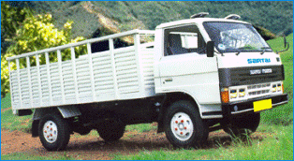
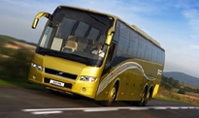
A Glance
Gross Sale - Rs 7 Crores/Per An.
Plan for Year 2018-19 - Rs 12 crores/Per An. (already 7.5 crores crossed)
Work Force - 65 Persons
Tota Area - Unit 1 – 6 Grounds
Unit 2 – 1 Ground at Ambattur
Unit 3 – 5 Grounds at Gummudipoondi
Fulfilling Needs…
On Highways & Sea – LCV . BUS. SUV.CAR.SHIP
Clutch Pedal Lever, Sub Assembly of Clutch Link, V Groove Pulley, Body, Driving Rings, Links,Adjusting Ring

Slide 10
Our Valued Customers…
1.
2.
3.
4.

Slide 11
Business With Our Customers…

Slide 12
TARGET : ZERO

Slide 14
TARGET : ZERO

Slide 15
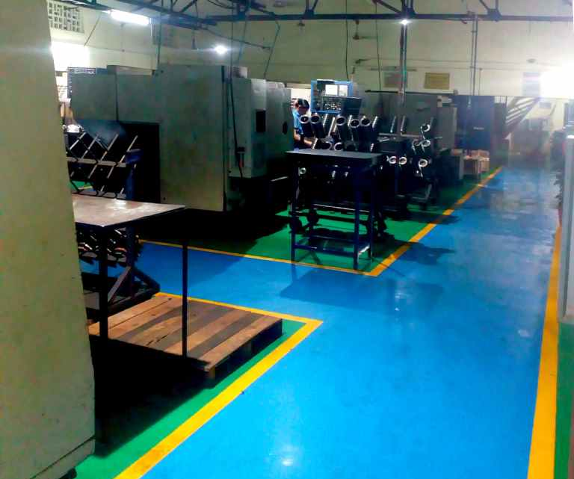
Our Company – Shop 1

Slide 16
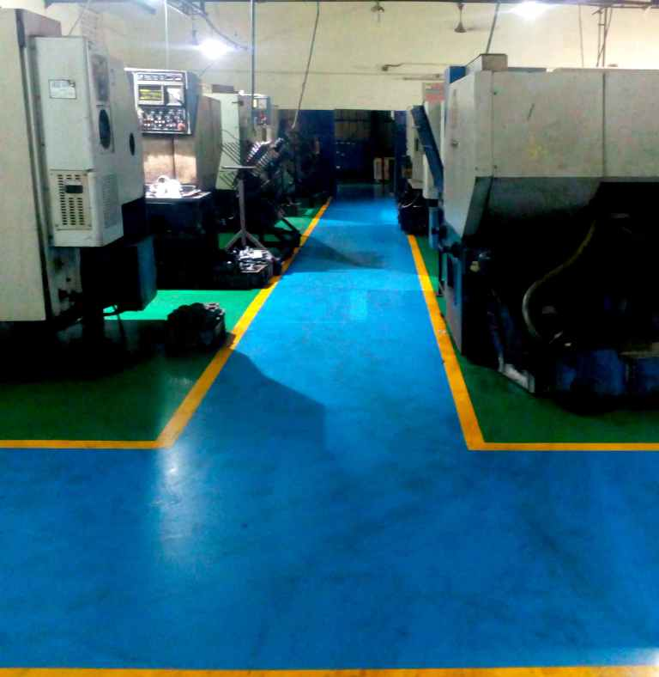
Our Company – Shop 2

Slide 17
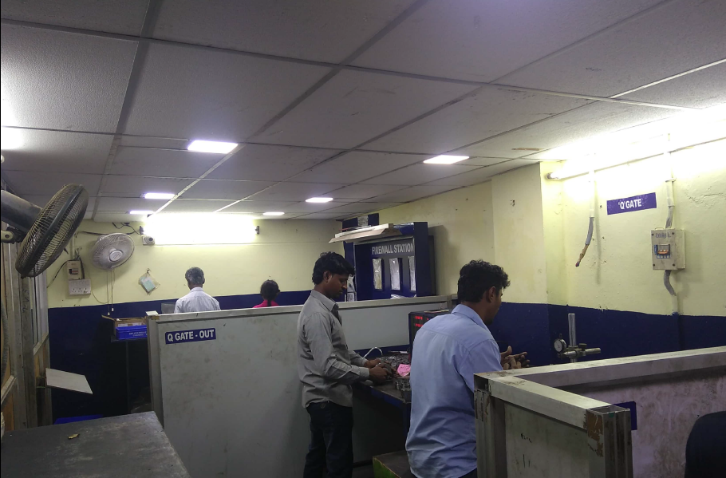
Our Company - (Final inspection cell)

Slide 18
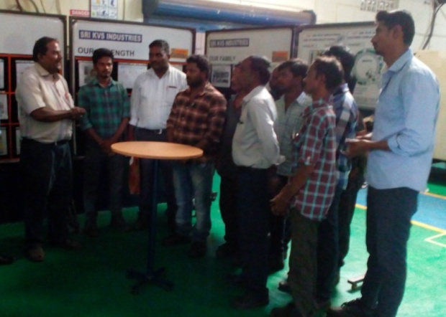
GEMBA Communication Centre
Daily We discussed customer requirement & inhouse production loss and quality issues with all our team leaders by our CEO and Plant Head.

Slide 19
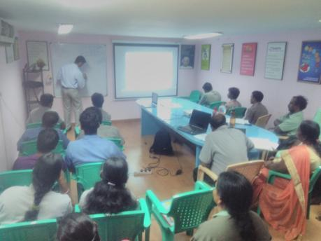
Training Hall

Slide 20
In-House Manufacturing Facilities

Slide 21
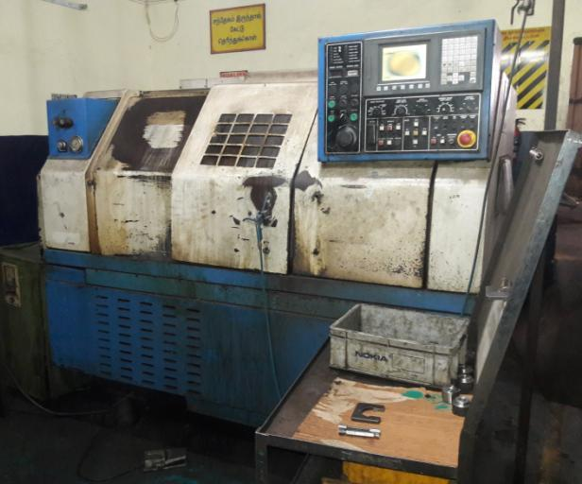
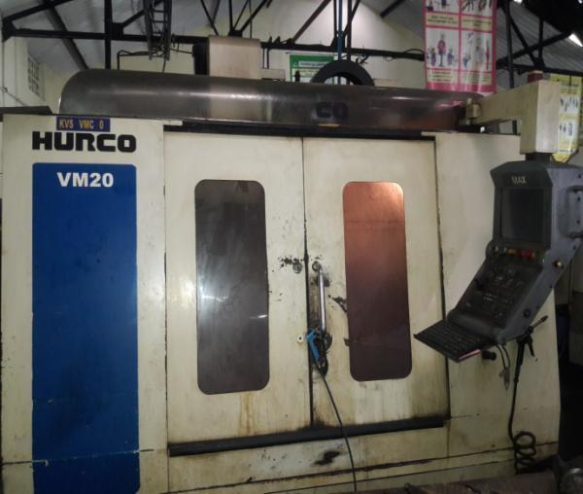
CNC Lathe
VMC Milling
Machine Name : | VMC-Milling
Capacity : | 800*600 bed size
No of Machines Available : | 4
Machine Name : | CNC-Lathe
Capacity : | 250 mm chuck dia
No of Machines Available : | 15

Slide 22
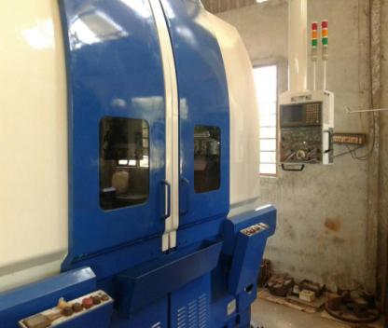
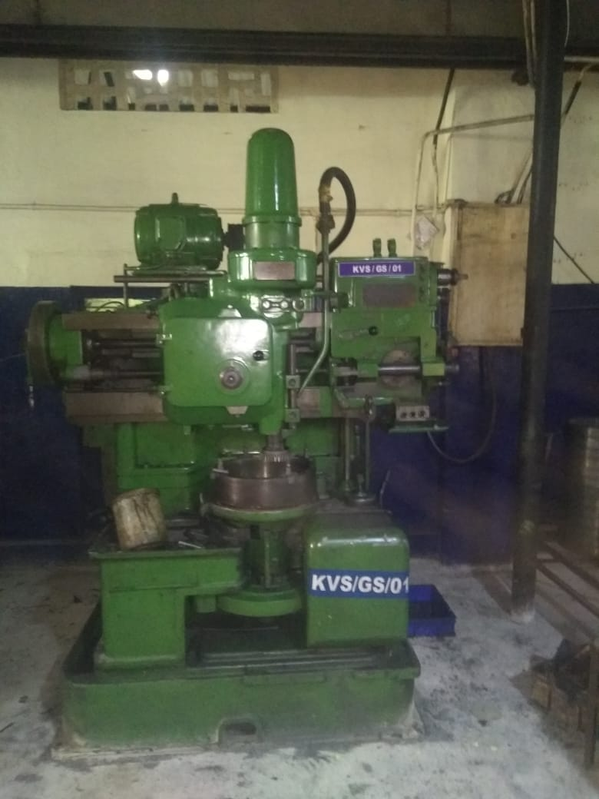
VTL Machine
Gear Shaping Machine
Machine Name : | VTL
Capacity : | 605 dia
No of Machines Available : | 2
Machine Name : | Gear Sheaving Machine
Capacity : | 600 dia
No of Machines Available : | 1

Slide 23
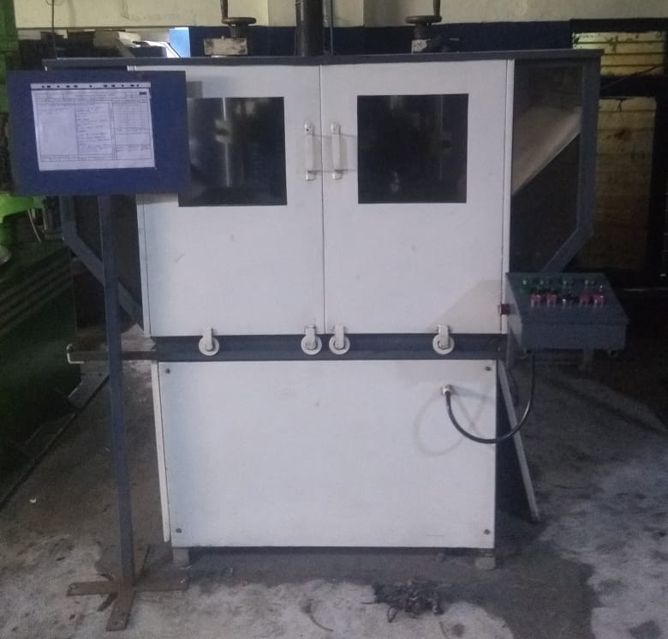
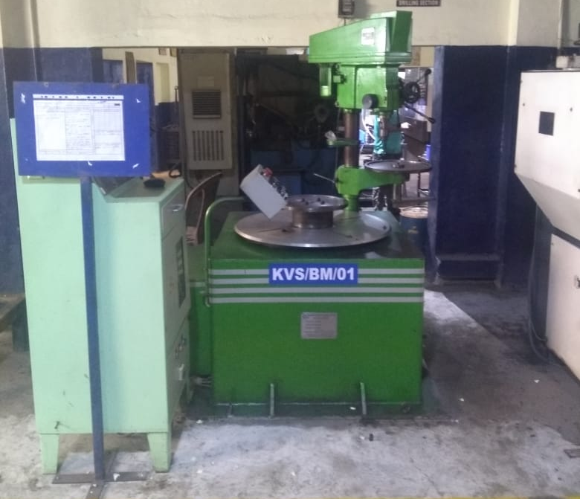
Tooth Chamfering Machine
Balancing Machine
Machine Name : | Tooth Chamfering Machine
Capacity : | 600 Dia
No of Machines Available : | 1
Machine Name : | Balancing Machine
Capacity : | 605 dia
No of Machines Available : | 1

Slide 24
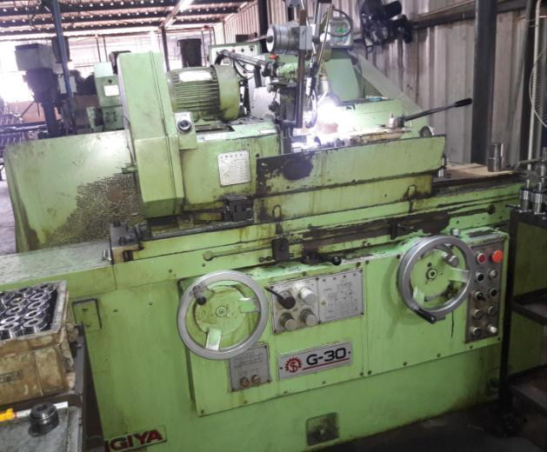
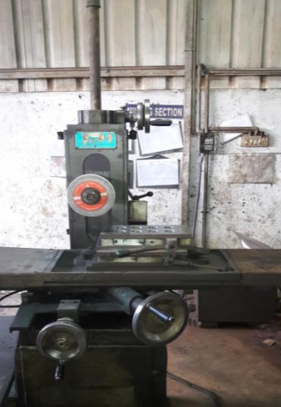
Cylindrical Grinding
Surface Grinding
Machine Name : | Cylindrical Grinding
Capacity : | 600 mm length
No of Machines Available : | 2
Machine Name : | Surface Grinding
Capacity : | 2 feet
No of Machines Available : | 2

Slide 25
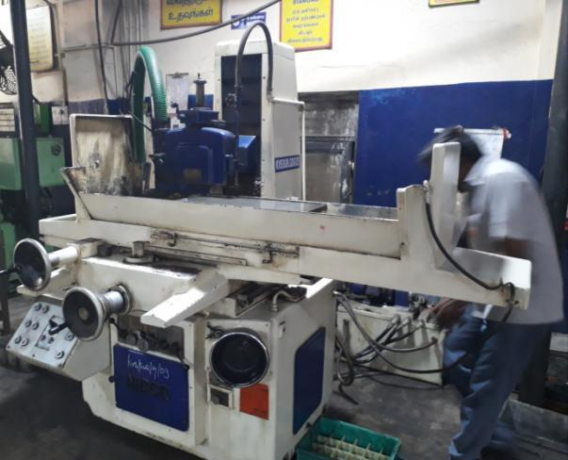
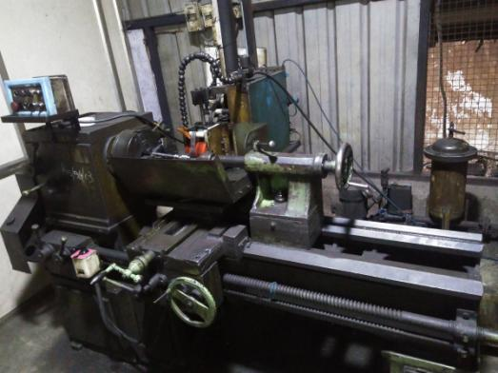
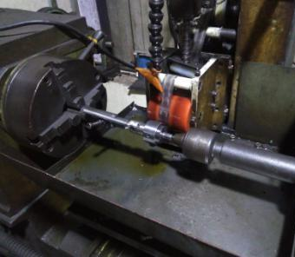
Surface Grinding
Polishing machine
Machine Name : | Polishing m/c
Capacity : | 6 feet
No of Machines Available : | 1
Machine Name : | Surface grinding
Capacity : | 1000 * 400 mm
No of Machines Available : | 1
Notes:
Flat?

Slide 26
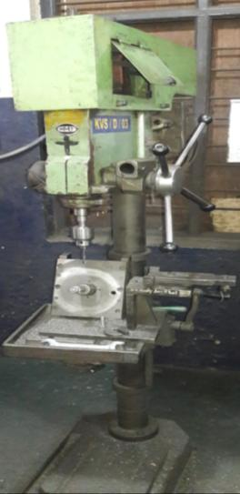
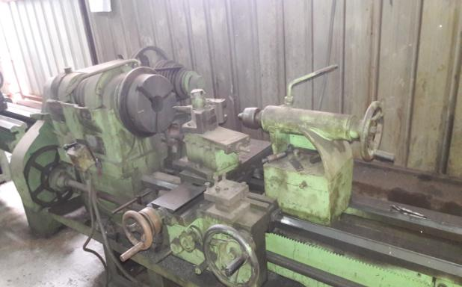
Conventional Lathe
Conventional Drilling
Machine Name : | Conventional lathe
Capacity : | 8 feet
No of Machines Available : | 3
Machine Name : | Conventional Drilling
Capacity : | 1 ½”
No of Machines Available : | 10
Notes:
Any other photo w/o cable on floor

Slide 27
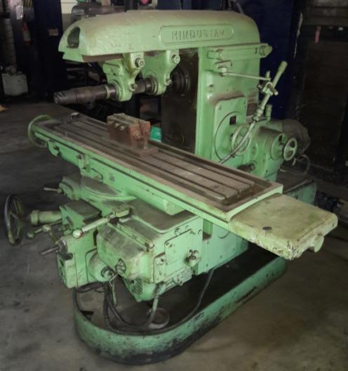
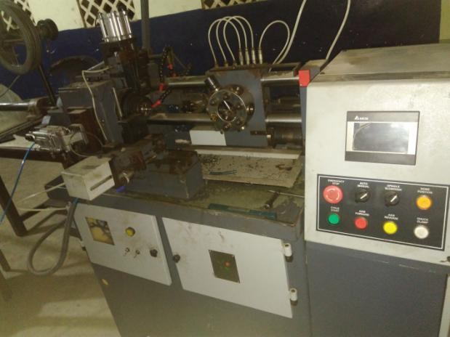
Conventional Milling
CNC Traub
Machine Name : | Conventional milling
Capacity : | HMT NO 2
No of Machines Available : | 2
Machine Name : | CNC - Traub
Capacity : | 25 / 32
No of Machines Available : | 1
Notes:
FN 2EH? Qty 1 or 2

Slide 28
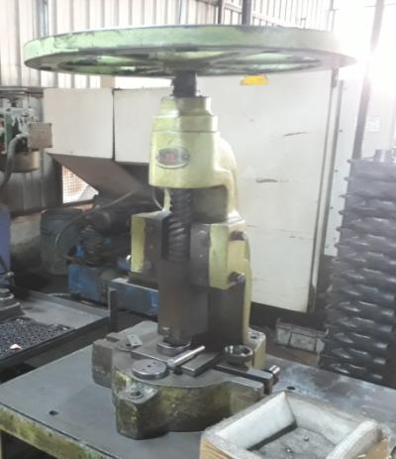
Hand Press
Machine Name : | Hand press
Capacity : | 1 Ton
No of Machines Available : | 1

Slide 29
In-House Testing Facilities
Notes:
Hardness testers

Slide 30
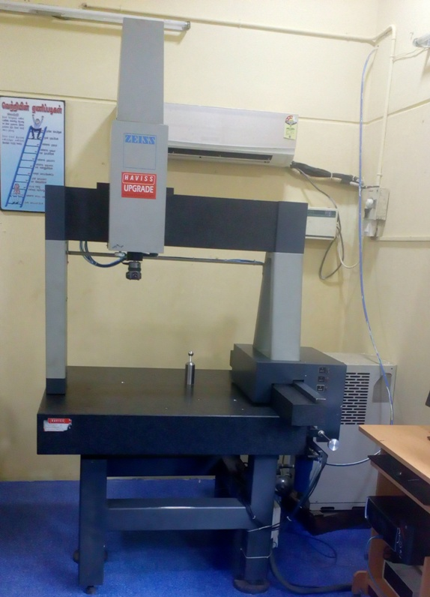
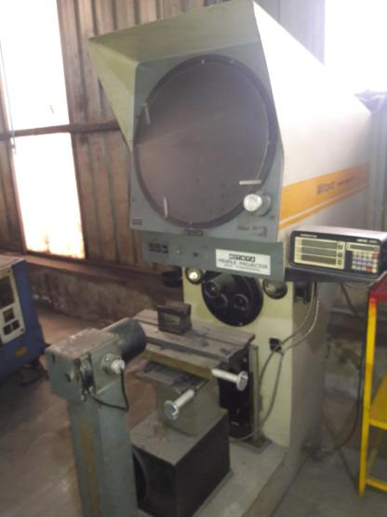
ZEISS CMM
Profile projector

Slide 31
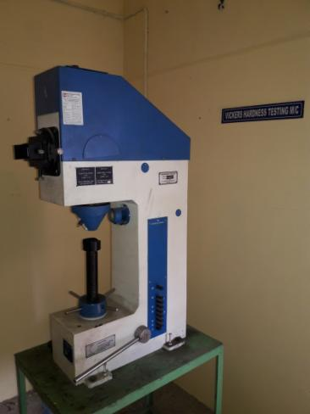
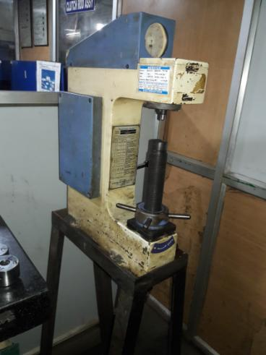
Vickers hardness testing m/c
Rockwell hardness testing m/c

Slide 32
Metalurgical Lab

Slide 33
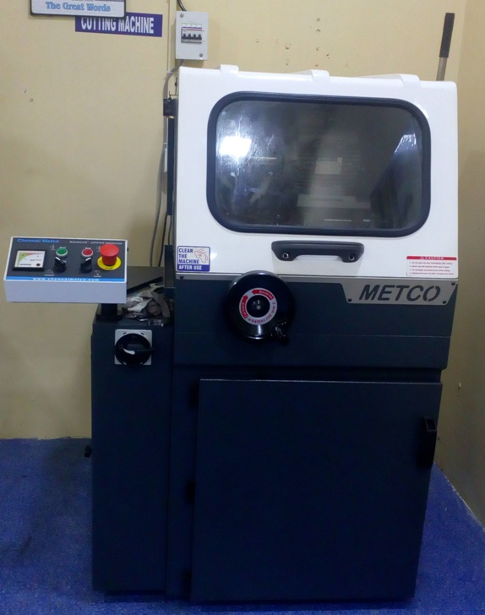
Cutting Machine

Slide 34
Moulding Machine

Slide 35
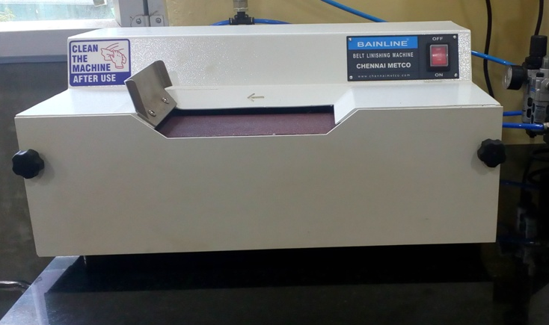
Grinding Machine

Slide 36
Polishing Machine

Slide 37
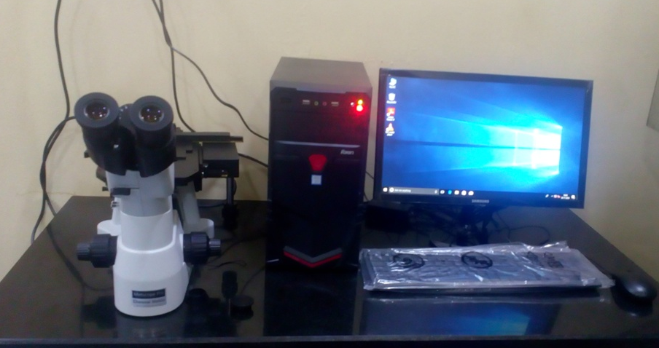
Microscope

Slide 38
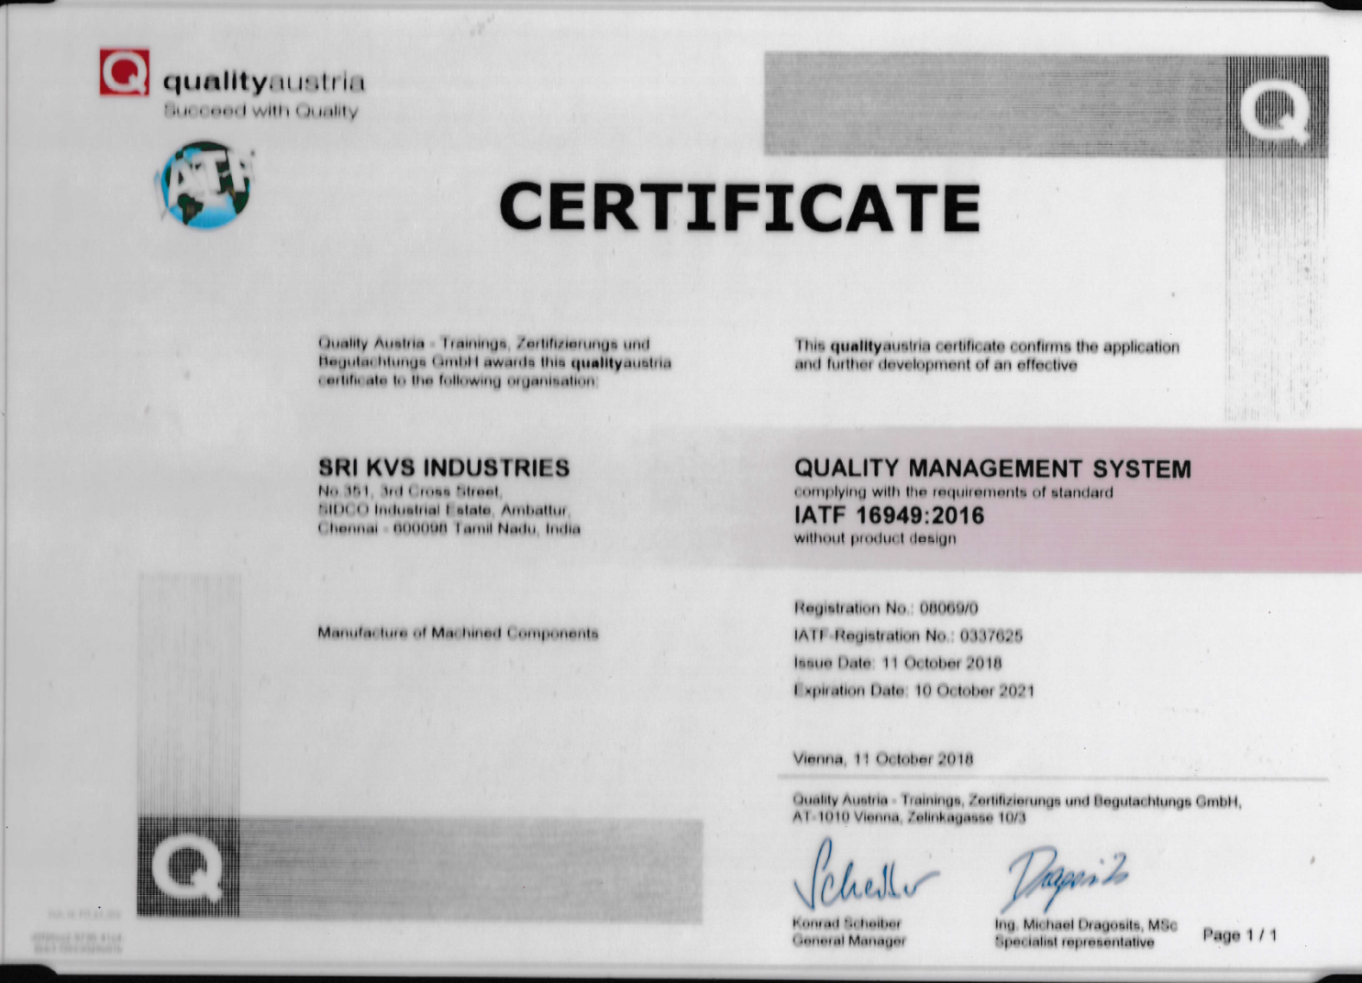
Certifications
We complying with the requirements of IATF16949:2016 in Nov-18
Notes:
We are TS 16949 Certified……

Slide 39
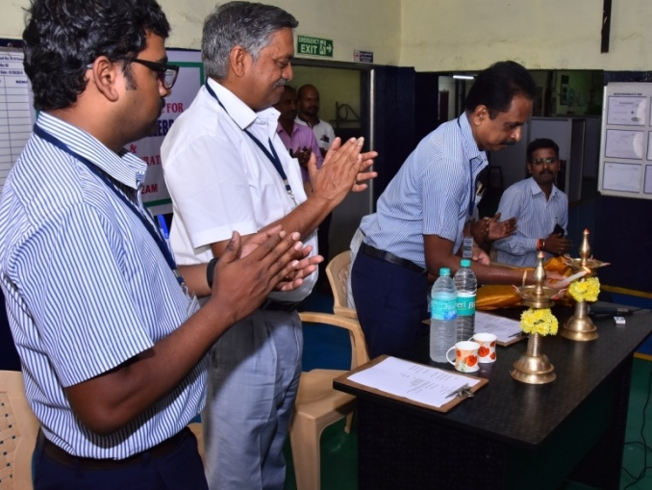
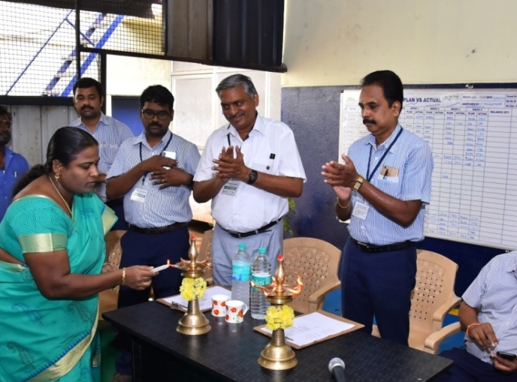
Quality Month Celebration - 2018
Lightening of kuthuvilaku
Notes:
We are TS 16949 Certified……

Slide 40
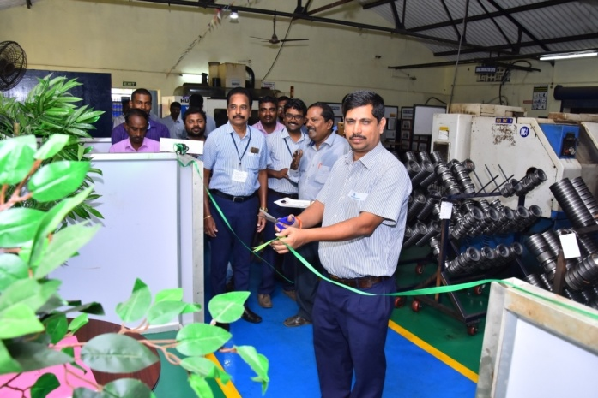
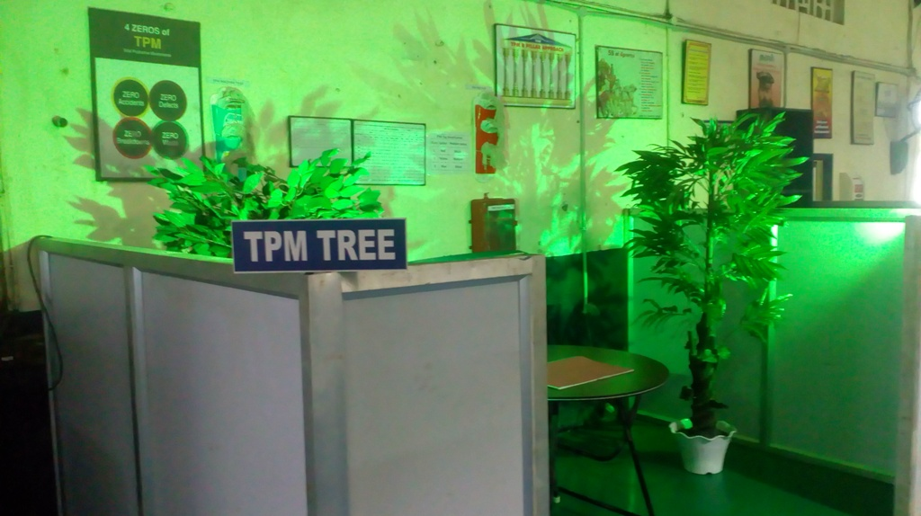
Quality Month Celebration - 2018
TPM Tree Inauguration
Notes:
We are TS 16949 Certified……

Slide 41
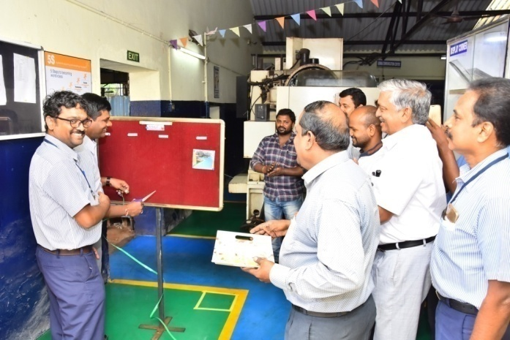
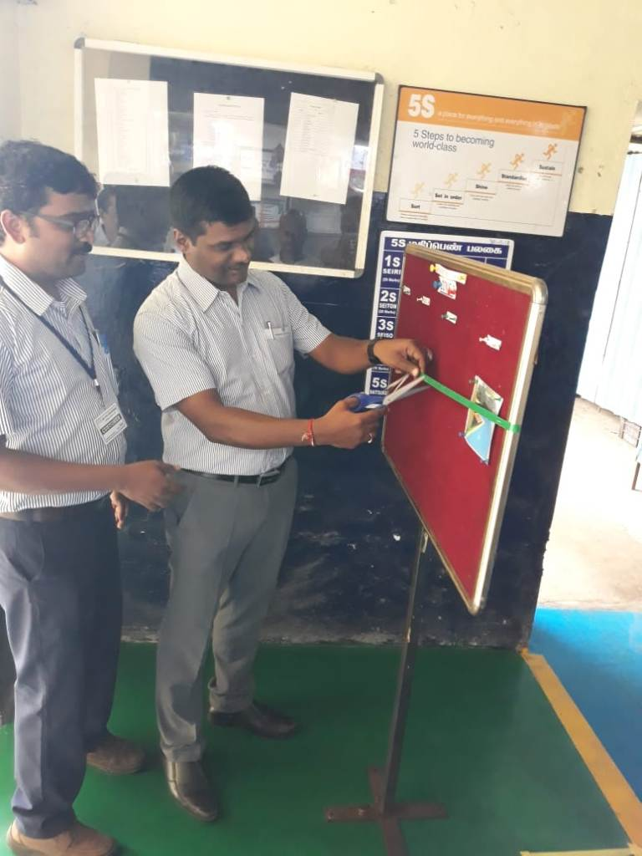
Fixed Point Photography Inauguration
Notes:
We are TS 16949 Certified……

Slide 42
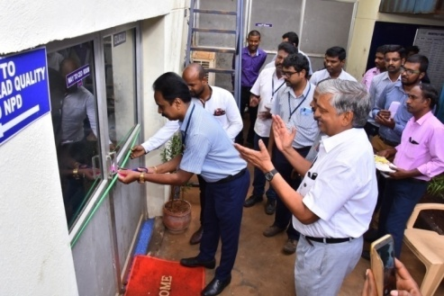
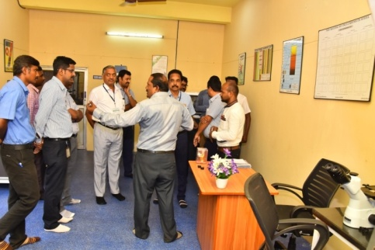
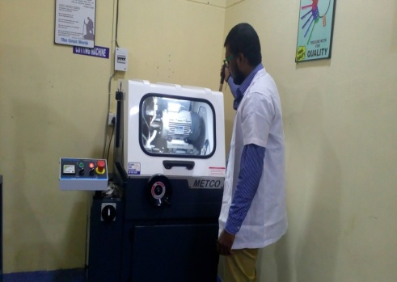
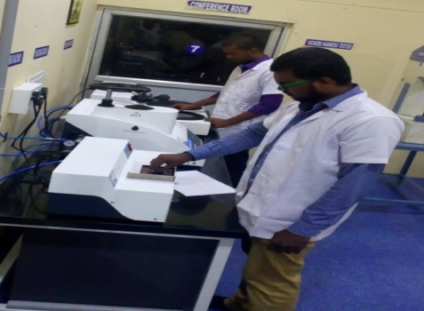
Metallurgical Lab Inauguration
Notes:
We are TS 16949 Certified……

Slide 43
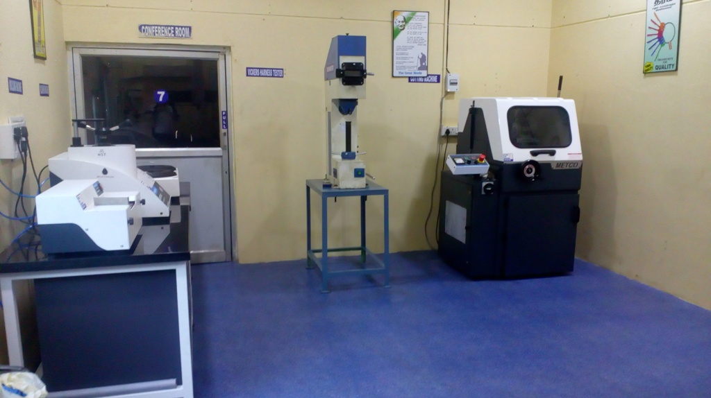
Metallurgical Lab Inauguration
Notes:
We are TS 16949 Certified……

Slide 44
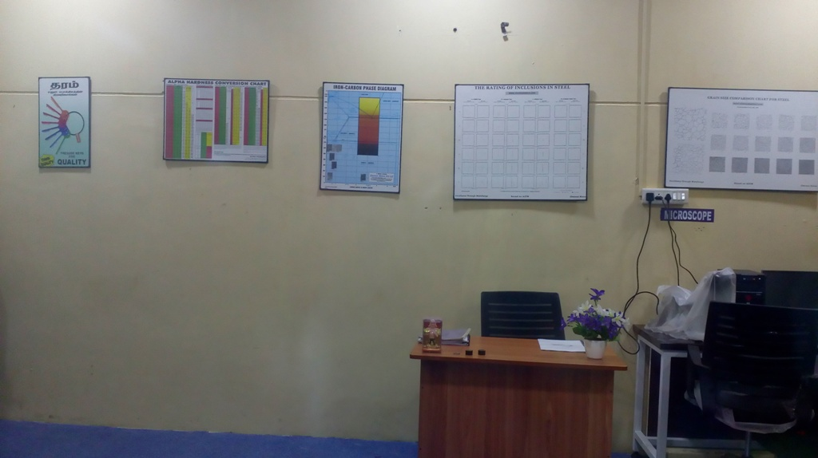
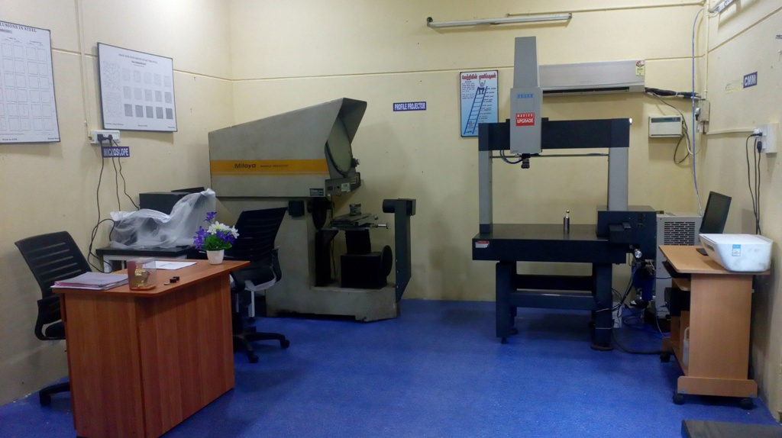
Metallurgical Lab Inauguration
Notes:
We are TS 16949 Certified……

Slide 45
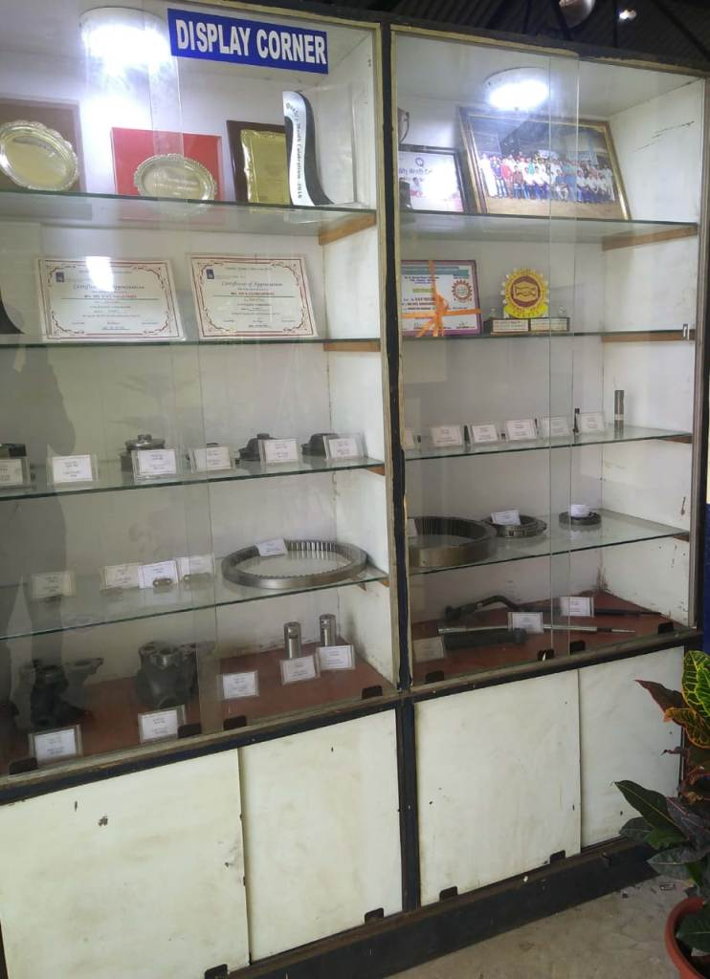
Display Corner

Slide 46
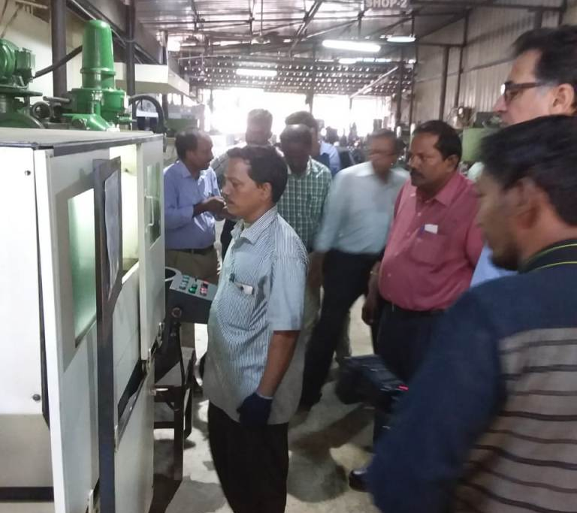
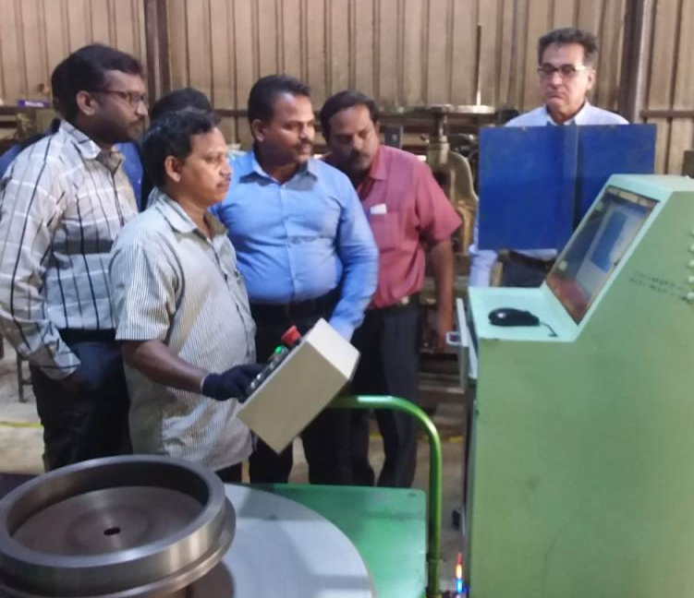
USA Export Customer Visit

Slide 47
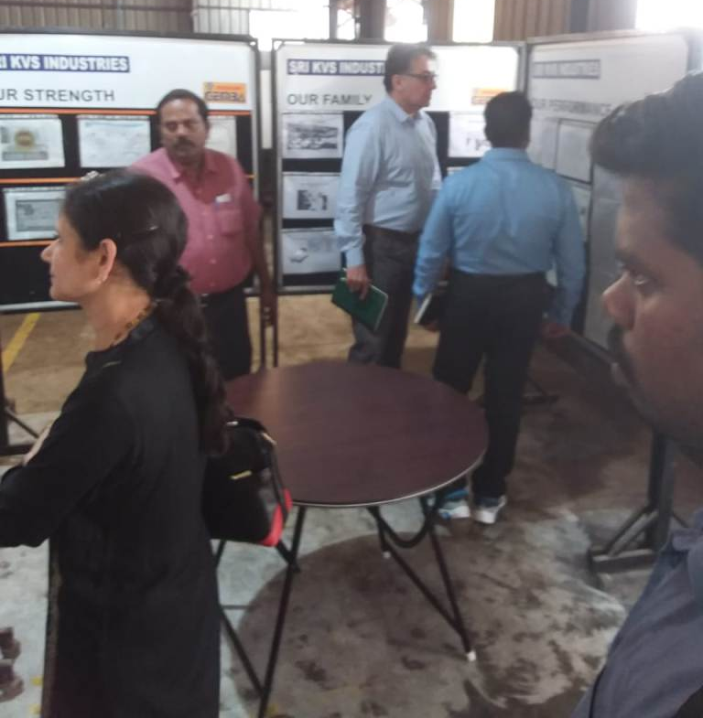

Slide 48
Employees Motivation for the Year - 2018
Best Quality acheivement Award to Mr.Dilip Sr.Inspector award given by Mr.R.Sethuraman Div Mgr-Ashok Leyland
Best 5SAward to Mrs.Sumathi award given by Dr.S.Nagendra Bhoopathy MD cardiologist Sri Ramachandra Hospital.

Slide 49
Employees Motivation
Best Productivity award
Best quality Award
Best Employee Award to Mr.Sabar Sr.Operator award given by Mr.Selvaraj DGM -SGL
Best Productivity Award to Mr.Bimali Operator award given by Mr.Dilip Babu Manager –Ashok Leyland

Slide 50
Motivation for T2 Supplier

Slide 51
Accolades

Slide 52
Out Sourced Facilities Tied - up
Induction Hardening
Heat Treatment
CED Coating
Phosphating
Plating
Foundry
1.Gopal Naicker&son
2.Adhithya Castings
Notes:
Heading can be : Outsourced Facilities Tied-up

Slide 53
Thank You

